Slide 1

SPARK

Slide 2
CONTENTS
Working with JSON Datasets
Working with Parquet Files

Slide 3
Working with JSON Datasets
Spark SQL can automatically capture the schema of a JSON dataset and load it as a DataFrame.
This conversion can be done using SQLContext.read.json() on either an RDD of String or a JSON file.
Spark SQL provides an option for querying JSON data along with auto-capturing of JSON schemas for both reading and writing data.
Spark SQL understands the nested fields in JSON data and allows users to directly access these fields without any explicit transformations.

Slide 4
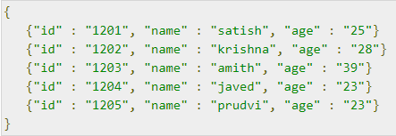
Example
Let us consider an example of employee records in a text file named employee.json. Use the following commands to create a DataFrame (df).
Read a JSON document named employee.json with the following content and generate a table based on the schema in the JSON document.
employee.json − Place this file into the directory where the current scala> pointer is located.

Slide 5
Let us perform some Data Frame operations on given data.
DataFrame Operations
DataFrame provides a domain-specific language for structured data manipulation. Here we include some basic examples of structured data processing using DataFrames.
Follow the steps given below to perform DataFrame operations

Slide 6
Read JSON Document
First of all, we have to read the JSON document. Based on that, generate a DataFrame named dfs.
Use the following command to read the JSON document named employee.json containing the fields − id, name, and age. It creates a DataFrame named dfs.

Slide 7

Output
The field names are automatically taken from employee.json.
Use printSchema Method
If you want to see the Structure (Schema) of the DataFrame, then use the following command.

Slide 8


Output
Show the data
If you want to show the data in the DataFrame, then use the following command.

Slide 9
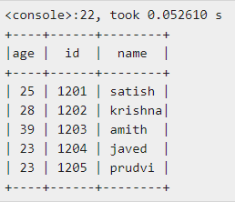
Output
You can see the employee data in a tabular format.
Then we can run different SQL statements in it. Users can migrate data into JSON format with minimal effort, regardless of the origin of the data source.

Slide 10
Working with Parquet Files
Parquet is a columnar format, supported by many data processing systems.
The advantages of having a columnar storage are as follows −
Columnar storage limits IO operations.
Columnar storage can fetch specific columns that you need to access.
Columnar storage consumes less space.
Columnar storage gives better-summarized data and follows type-specific encoding.

Slide 11
Spark SQL provides support for both reading and writing parquet files that automatically capture the schema of the original data. Like JSON datasets, parquet files follow the same procedure.
Let’s take another look at the same example of employee record data named employee.parquet placed in the same directory where spark-shell is running.

Slide 12

Given data
Do not bother about converting the input data of employee records into parquet format.
We use the following commands that convert the RDD data into Parquet file.
Place the employee.json document, which we have used as the input file in our previous examples.

Slide 13
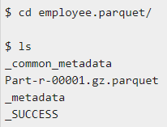
It is not possible to show you the parquet file.
It is a directory structure, which you can find in the current directory.
If you want to see the directory and file structure, use the following command.
The following commands are used for reading, registering into table, and applying some queries on it.

Slide 14
Open Spark Shell
Start the Spark shell using following example
Create SQLContext Object
Generate SQLContext using the following command. Here, sc means SparkContext object.

Slide 15
Read Input from Text File
Create an RDD DataFrame by reading a data from the parquet file named employee.parquet using the following statement.
Store the DataFrame into the Table
Use the following command for storing the DataFrame data into a table named employee. After this command, we can apply all types of SQL statements into it.

Slide 16
The employee table is ready.
Let us now pass some SQL queries on the table using the method SQLContext.sql().
Select Query on DataFrame
Use the following command for selecting all records from the employee table.
Here, we use the variable allrecords for capturing all records data.
To display those records, call show() method on it.

Slide 17

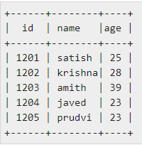
To see the result data of allrecords DataFrame, use the following command.
Output

Slide 18
END OF SESSION
Q&A

